Slide 1
Schedule Assistant
Course Registration Tips

Slide 2
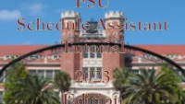
SCHEDULE ASSISTANT VIDEO

Slide 3
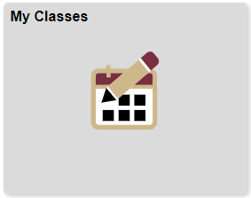
Open Schedule Assistant - my.fsu.edu
SC icon
My Classes tile
Schedule Assistant
Notes:
How to open Schedule Assistant:
Go to my.fsu.edu, log in
Click the SC icon to enter Student Central
Select the My Classes tile
Click Schedule Assistant on the left menu; you’ll be prompted to Open Schedule Assistant in a new tab/browser window
Make sure you pop-up blocker is off

Slide 4
Set the Filters
Tip #1
Notes:
Tip #1 – Start by setting the filters

Slide 5
Setting Filters
Term
Summer or Fall
Sessions
Summer → B – 2nd Six Weeks
Fall → Regular Academic Session
Course Status
Open Classes Only
Campuses
Tallahassee
Academic Careers
Undergraduate
Notes:
Open classes only make sure you only search for class sections that have seats available right now.
Campus should be set to Tallahassee. You can only enroll in Tallahassee campus classes (not Panama City or Republic of Panama).
Term – Summer or Fall, depending on which you are enrolling in.
Make sure to weed out classes you can’t take by selecting the right session (Summer is B – 2nd six weeks; Fall is Regular Academic Session)

Slide 6
Search for Courses
Tip #2

Slide 7
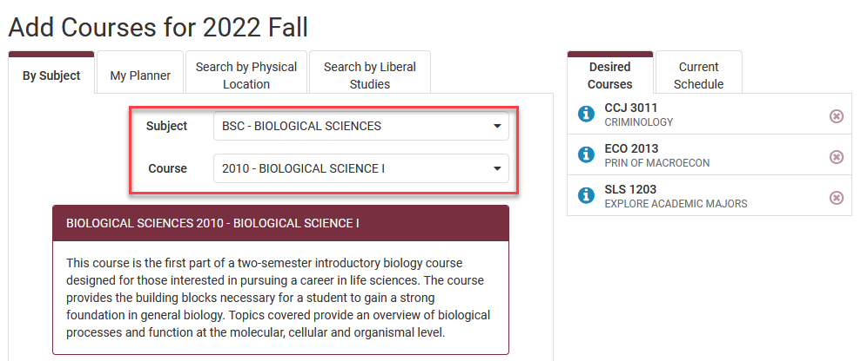
Search for Courses
Click the red +Add Course button.
Select one of the tabs to search for a course.
If you already know the subject and course number, the By Subject tab would be the best tab to use.
Notes:
Click the red +Add Course button to search for courses.
You can search for classes by:
Subject – use this if you have a specific course number from your advisor (ex. ENC 1101)
Search by Liberal Studies – a great way to find different kinds of gen ed & liberal studies classes (best if your advisor says “any History class” for example)

Slide 8
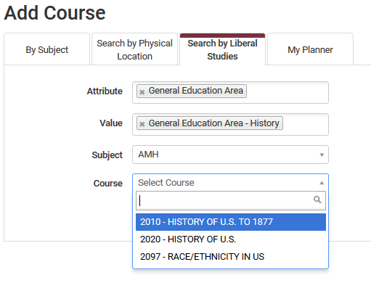
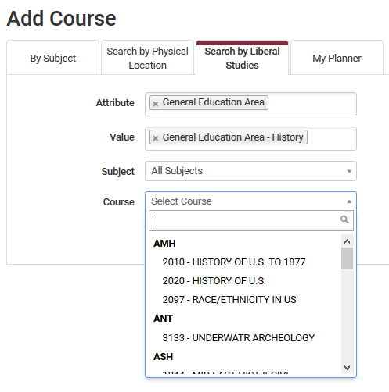
Finding Liberal Studies Classes
Select the Search by Liberal Studies tab.
Use dropdown fields for Attribute and Value to select the Liberal Studies area(s) you for which want to find courses.
Select the Course field to view a list of all courses offered in each subject.
Notes:
Your advisor might suggest Liberal Studies or General Education Courses.
These are grouped into types like “History”, “Humanities”, or “Oral Communication Competency.
There are often many classes to choose from if they tell you that you can take any “History” class, for example.
The best way to find those classes is the using the “Search by Liberal Studies” tab. Then you get to choose what seems like it will be most interesting to you!
Some classes are for specific majors, so make sure to view the Sections later to ensure there aren’t reserve caps.

Slide 9
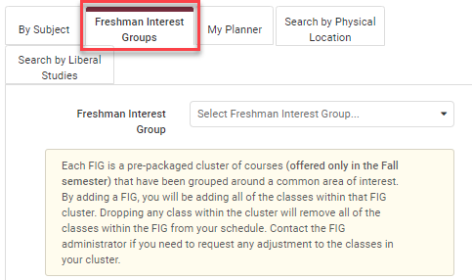
Freshman Interest Groups
Select the Freshman Interest Groups tab.
Search for the FIG using the pull-down menu.
Select the correct FIG topic and click “Add Course”.
When searching, topics look like:
03-Business (ENC,CGS,ECO)
This adds the FIG colloquium (HUM1920) and all courses that come in the FIG cluster.
Notes:
Your advisor might suggest you enroll in a FIG – a cluster of high-demand freshman classes clustered by major/academic interest.
You must use the Freshman Interest Groups tab to enroll in the FIG cluster.
Only freshmen/first-year students have this tab, not transfer students.
Note: You cannot add a FIG through the By Subject tab by just searching for HUM1920. It will not include all the courses in the FIG cluster!
Use the FIG tab
Search by FIG topic/name (ex. 03-Business (ENC,CGS,ECO))
Search and add your FIG cluster to your schedule first, then add other classes around that.

Slide 10
Review Class Sections
Tip #3
Notes:
Reviewing available sections of a class help you narrow down your options and select preferred sections based on things like days/times, instructor, and delivery (in-person or online).

Slide 11
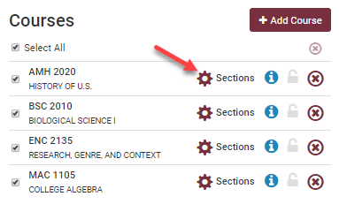
View & Select Sections
Click the Sections gear icon beside each course to view the sections available.
This is how to see each section’s:
Day/time/location
Physical Location
Main, Tallahassee = In-person
Online = Online
Instructor
Reserve caps
Notes:
This is how you can see the available sections for a course! Make sure you click the Sections gear icon and review the available sections for each course. There may be a few, or there may be 50! This helps narrow down your schedule options taking your preferences into account.
You can select the sections you prefer
You can deselect sections you don’t want in your schedule
Don’t go crazy! You’ll want to keep some sections of each class checked to maximize your options.
Pay close attention to classes with reserve caps (next slide)

Slide 12
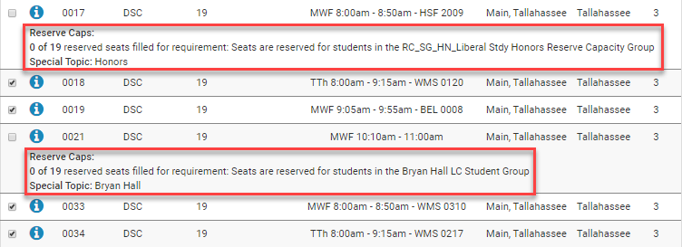
Reserve Caps & Special Topics
Check for any sections on the list that have a Reserve Caps or Special Topic note.
Reserve caps will have a note the specifies if a course is reserved for students in Honors, CARE, an LLC, a specific major, etc.
Use the check boxes on the left to deselect any section(s) reserved unless you are in that specific program.
Pro Tip!
You may also uncheck any sections that you prefer not to take.
Notes:
Things you will see when you view the sections:
Section Number
Component, examples
LEC = lecture
LAB = laboratory
DSC = discussion (often called recitation)
Seats Open
Instructor
If blank or says “Staff”, class is happening! The instructor information will be added later.
Days(s) & Location(s)
Days, times, classroom
If listed as TBD – likely an online class
Physical Location
Main, Tallahassee = in-person class meetings
Online = online class
Campus
You can only register for Tallahassee campus classes, even if the class is online.
Credits
Number of credit hours for the class
Note the red boxes. These classes have reserve cap (or reserve capacities). That means these specific sections have some or all seats reserved in a special program like Honors, CARE, a LLC (living learning community), a specific major, etc.
Use the check boxes on the left to deselect any section(s) reserved unless you are in that specific program.
Click the blue info button for full class details, including any notes about the class and textbooks

Slide 13
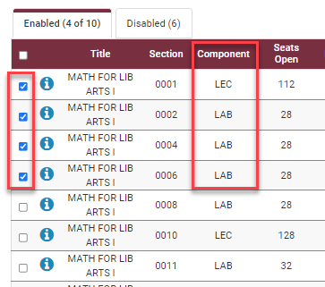
Multi-Component Classes
Most common for Math & certain Sciences
You must enroll in two sections:
Lecture & Lab = LEC & LAB
Lecture & Discussion = LEC & DSC
When selecting sections, be sure to have at least one lecture and one associated LAB/DSC checked.
Notes:
Multi-component classes are most common in Math and some sciences. That means you must register for both a Lecture (LEC) and corresponding LAB or Discussion (DSC). Combo varies by class.
When selecting sections, have at least one lecture and one associated lab or discussion checked. They are grouped together.
In this example, the Lecture section 0001 is associated with LAB sections 0002-0008. You would need to select the lecture and one or two of the labs listed right below that.

Slide 14
Pro Tips!
Notes:
A few pro tips to help you avoid problems during course registration.

Slide 15
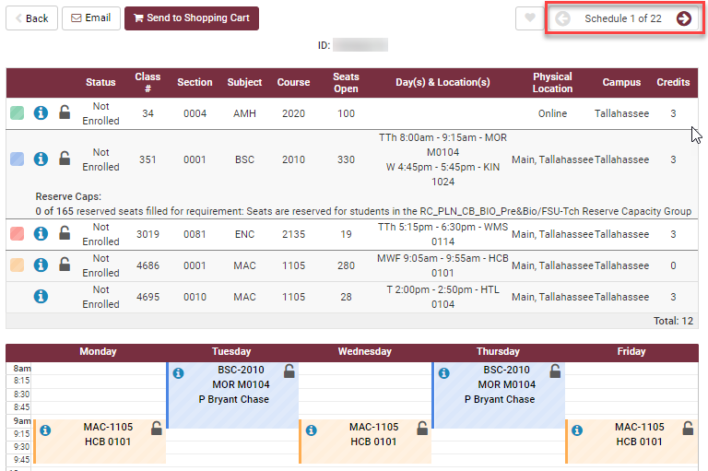
Shopping Cart
After you Generate Schedules and choose a favorite, send the classes to your Shopping Cart.
Adding classes to your cart does not hold a space!
Notes:
When you generate schedules, you won’t see online, asynchronous classes on the calendar view because they don’t have days & times, but you will see them listed at the top!
Adding classes to your shopping cart does not hold a space in that class for you! You must actually register in the class to have a secured seat.

Slide 16
English & Math Classes
Students may not drop these without permission of their academic dean.
English Composition - ENC1101 & ENC2135
Lower-level Math - MGF1106, MGF1107, MAC1105, & MAC1140
Need a different section than the one you chose? Use the Swap to switch from one section of a class to another.
Need to drop it all together? Contact the Office of Undergraduate Studies at undergradstudies@fsu.edu
Notes:
If you register in one of these English or Math courses, Schedule Assistant will not let you drop that class on your own. But you can change to a different section for a different day/time on your own using Swap.
Contact the Office of Undergraduate Studies for assistance if you need to drop the class from your schedule altogether. At Orientation, you can also get help with this at the Course Registration Lab later this morning.

Slide 17
Final Pro Tips
Don’t overdo it when adding Breaks.
FSU does not use Wait Lists.
You must Register & get a green checkmark for each class to be fully enrolled in that section.
If you try to register for a class and you can’t:
Go to your Shopping Cart and clear out that class.
Go back to Courses on the main page & look for other available sections (pay attention to reserve caps).
Generate Schedules and try again.

Slide 18
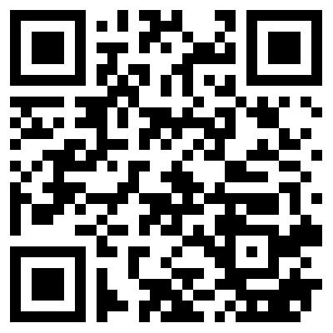
Schedule Assistant How-To Website
Visit: https://tinyurl.com/fsu-registration

